Slide 1

Library Management System
CS 5600 | CRN 30559
By
Chandan Dhonadhi Yathiraju
Hemanth Rasabhathula
Nikhith Raju Konduru
Srikanth Adhula

Slide 2
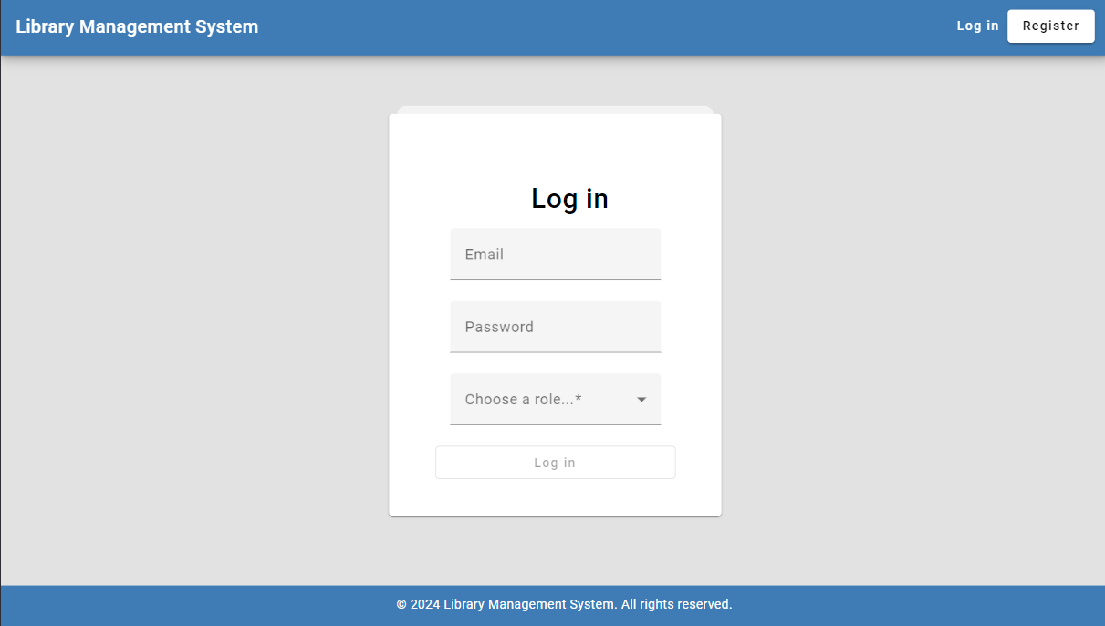
Library Management System (LMS)
Web-based application for librarians and users
Automates various library operations.
User-friendly interface for easy interaction.

Slide 3
Librarian/Admin Functionalities
Book Management: Add, update, and remove book entries with details like title, author, and genre.
Branch Management: Manage library branches, including adding new ones and updating information.
Transaction Management: View all user transactions, such as copy id, branch id, and the date of the transaction.
User Management: View User/Member accounts.

Slide 4
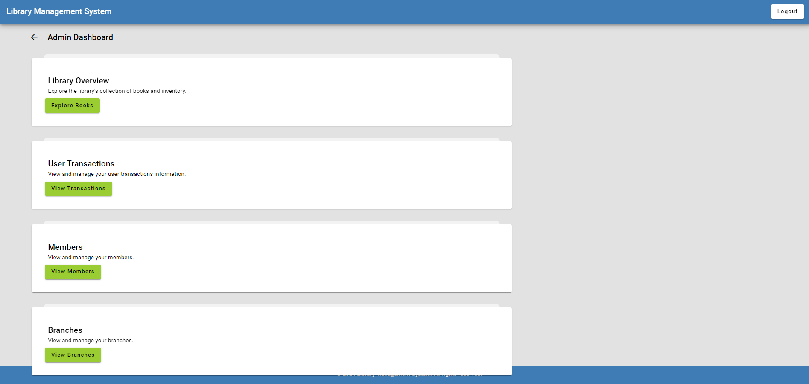
Admin dashboard

Slide 5
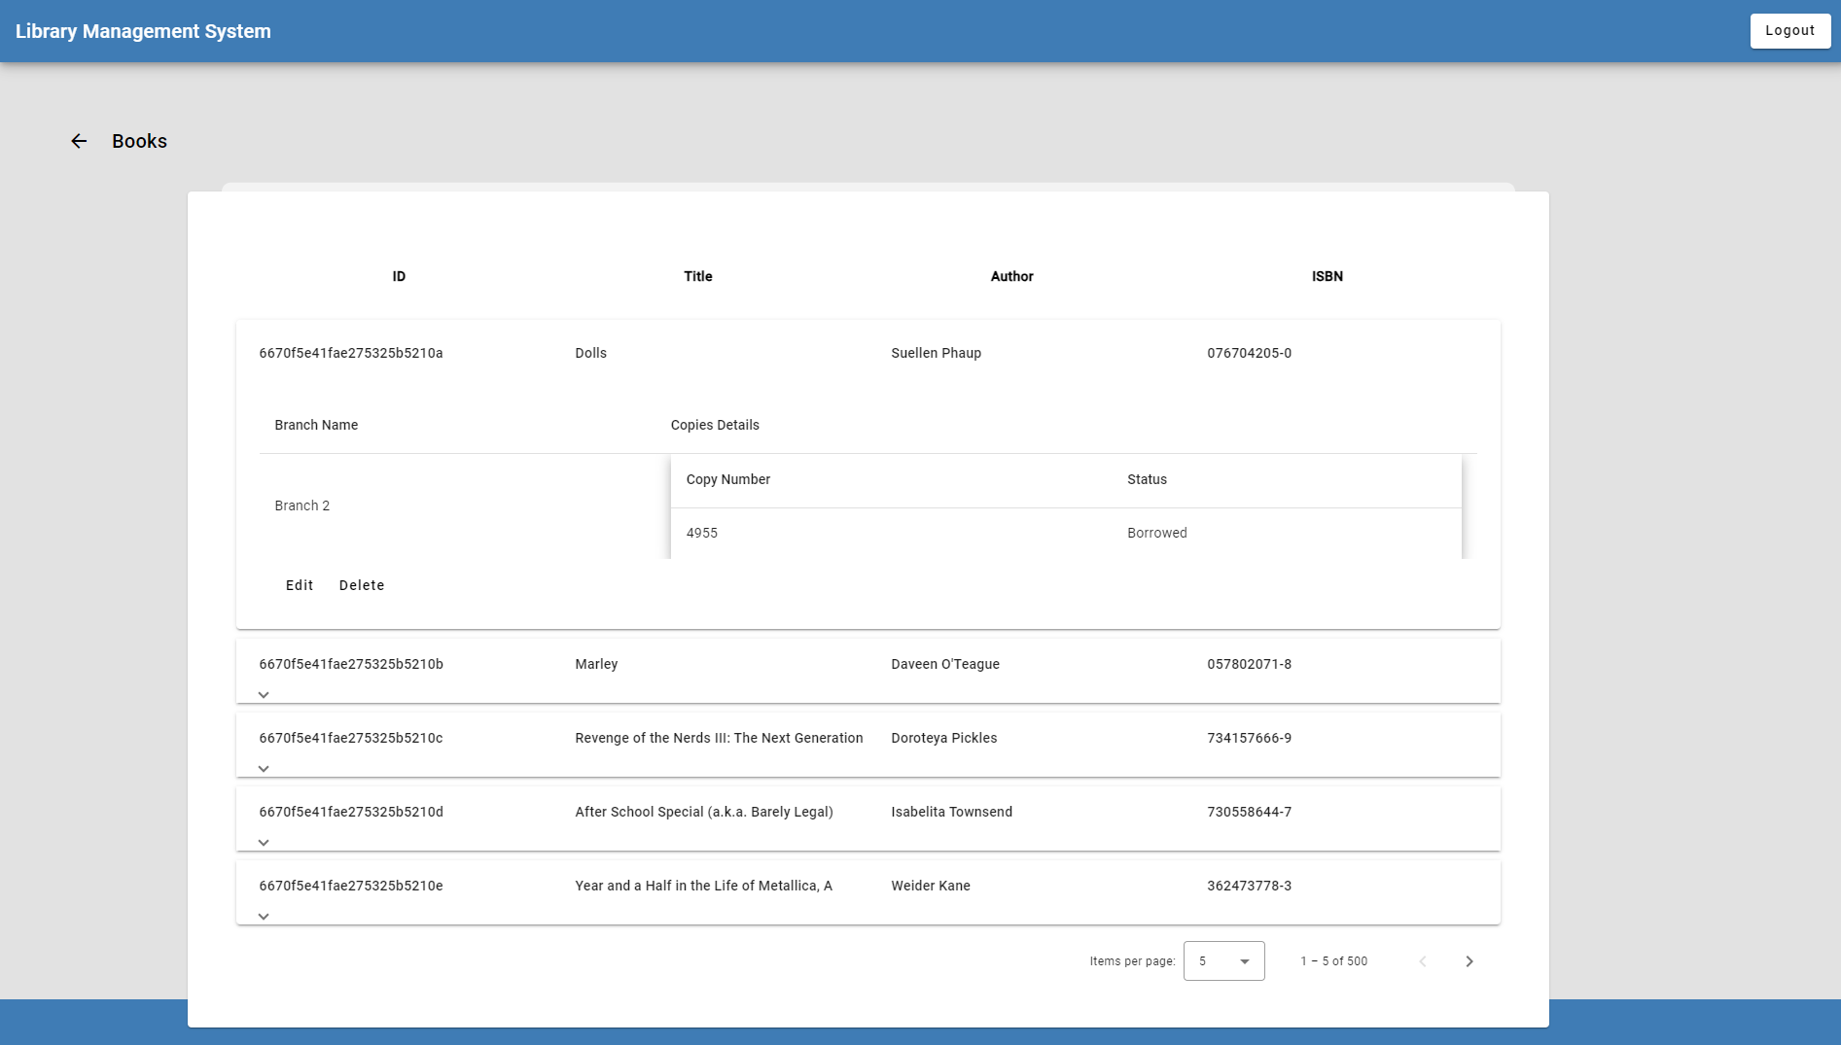
Book Management

Slide 6
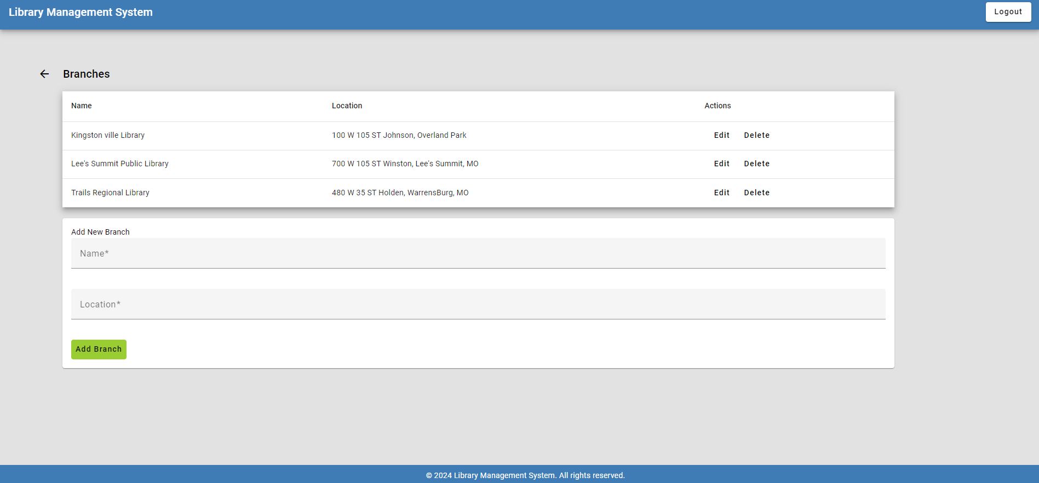
Branch Management

Slide 7
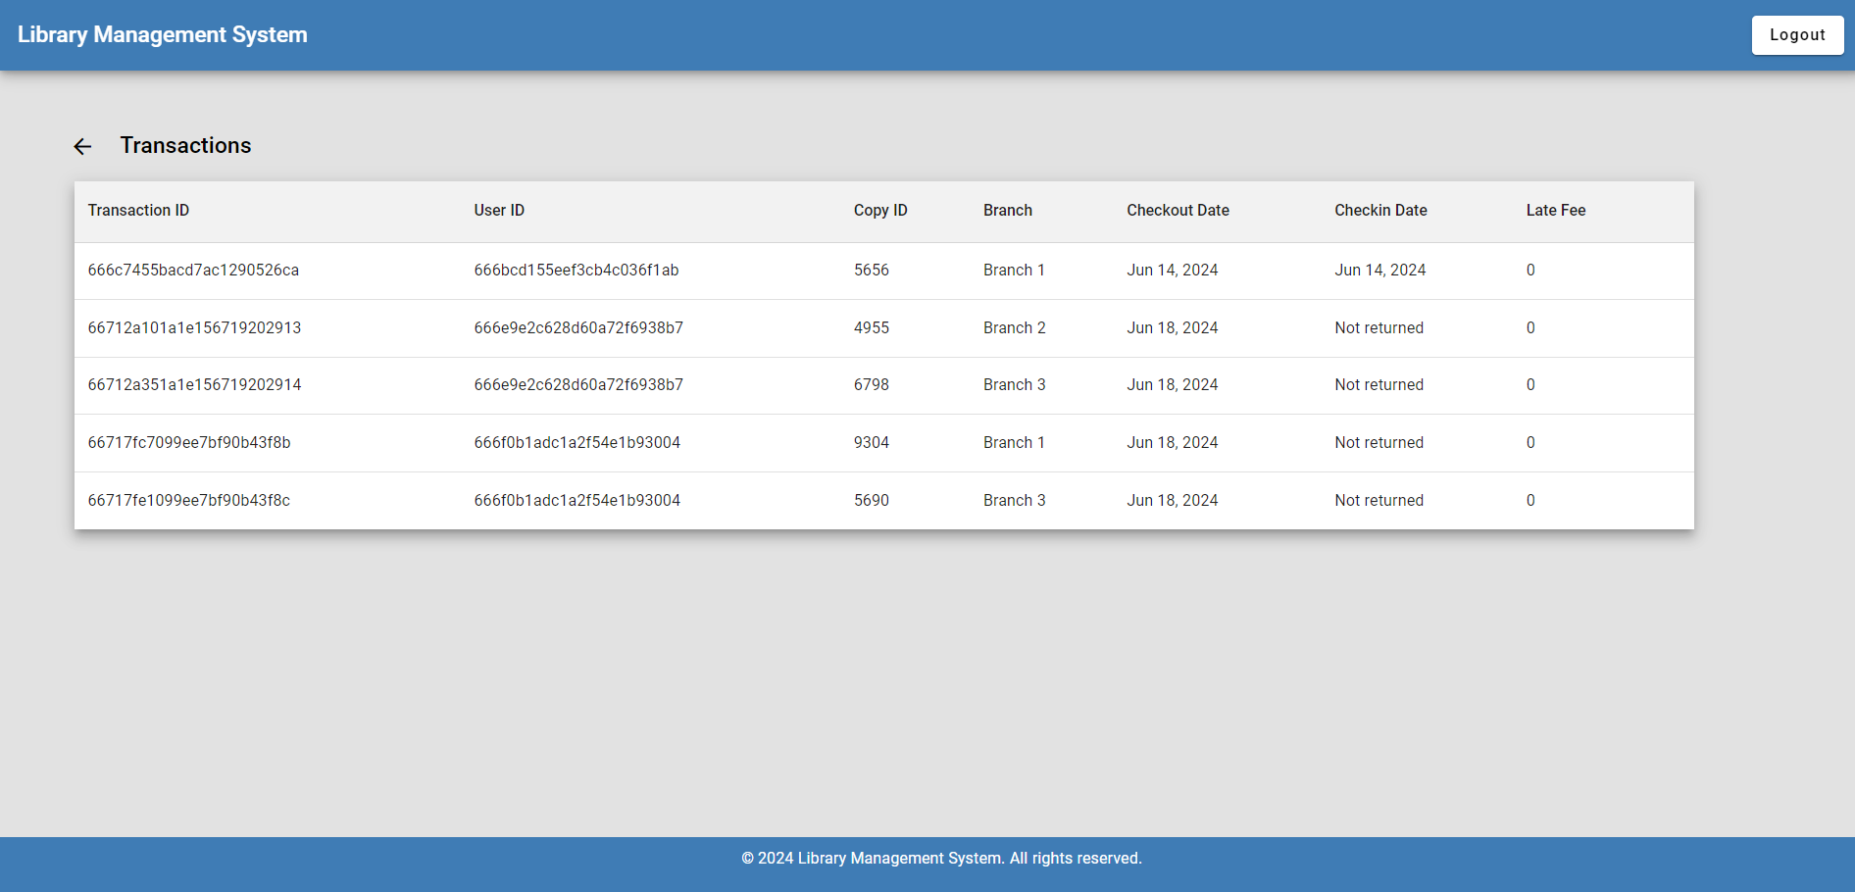
View all Transactions

Slide 8
User-Friendly Borrowing System
Hassle free login: Users can have an LMS account by registering and can login to browse the books collection.
Borrowing Books: Users can go through the books online and initiate borrows by adding to the cart.
Track Transaction History: Users can access their transaction history to keep track of borrowed items and due dates.

Slide 9
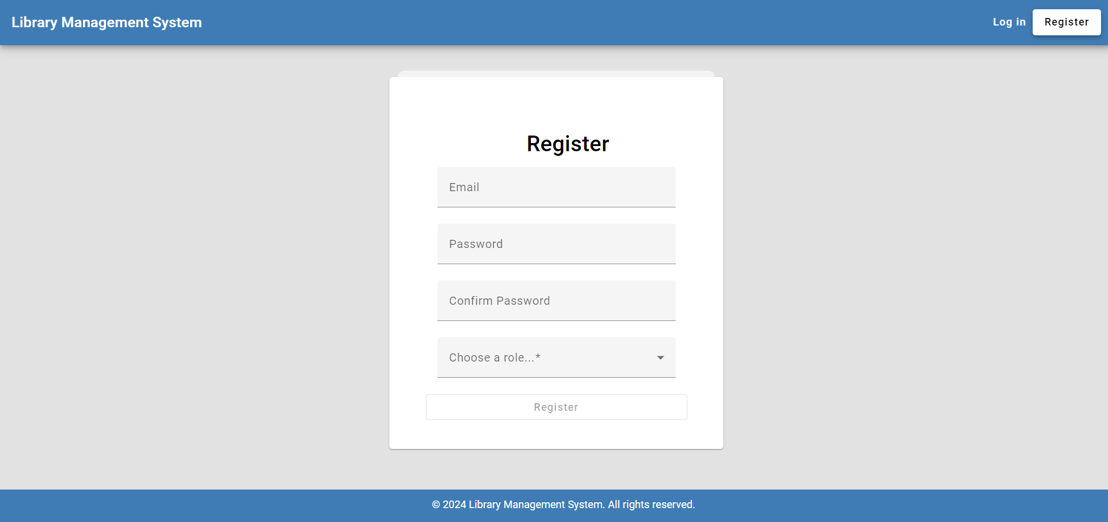
User Registration

Slide 10
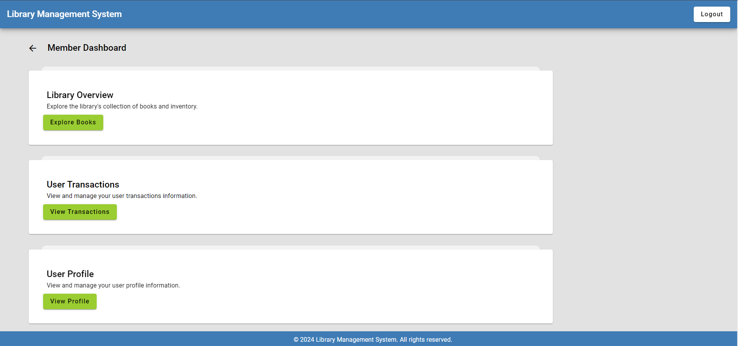
Member Dashboard

Slide 11
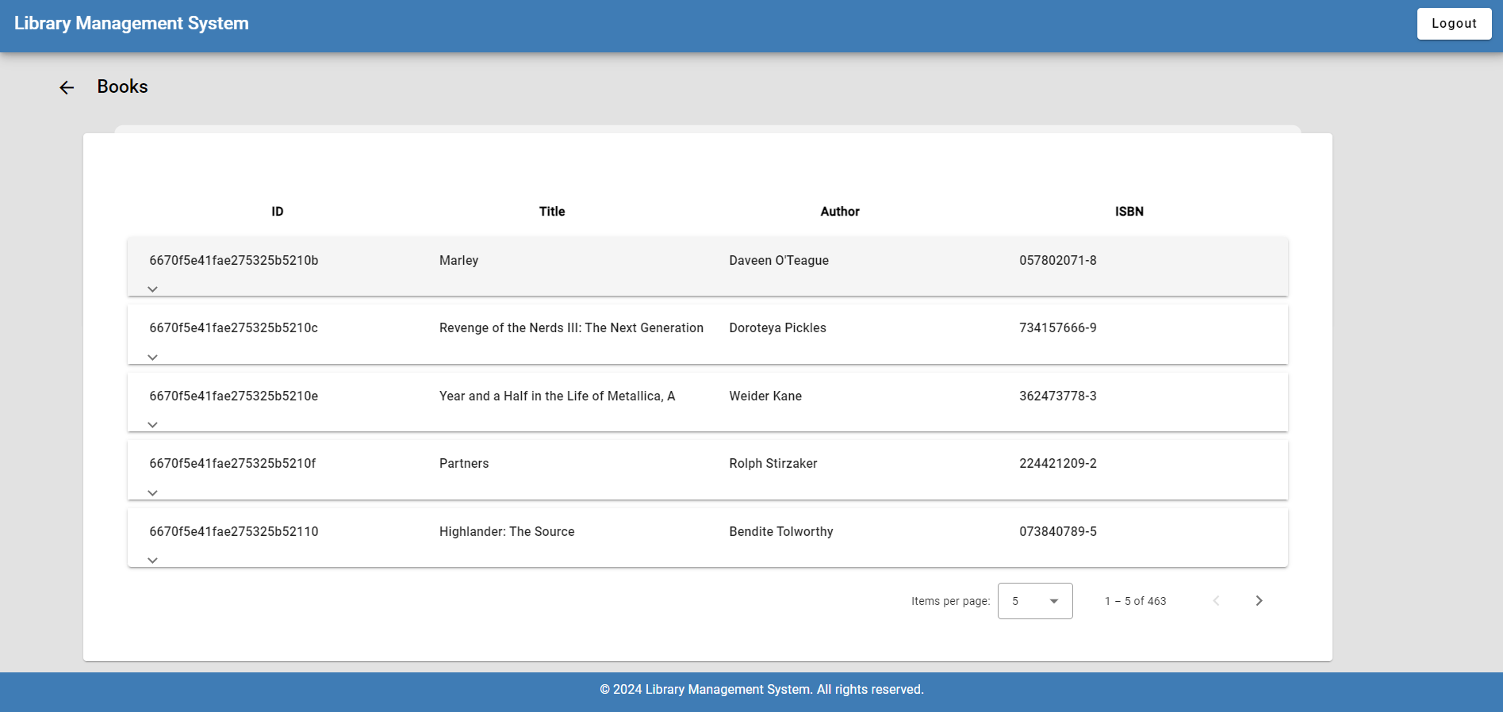
Browse books

Slide 12
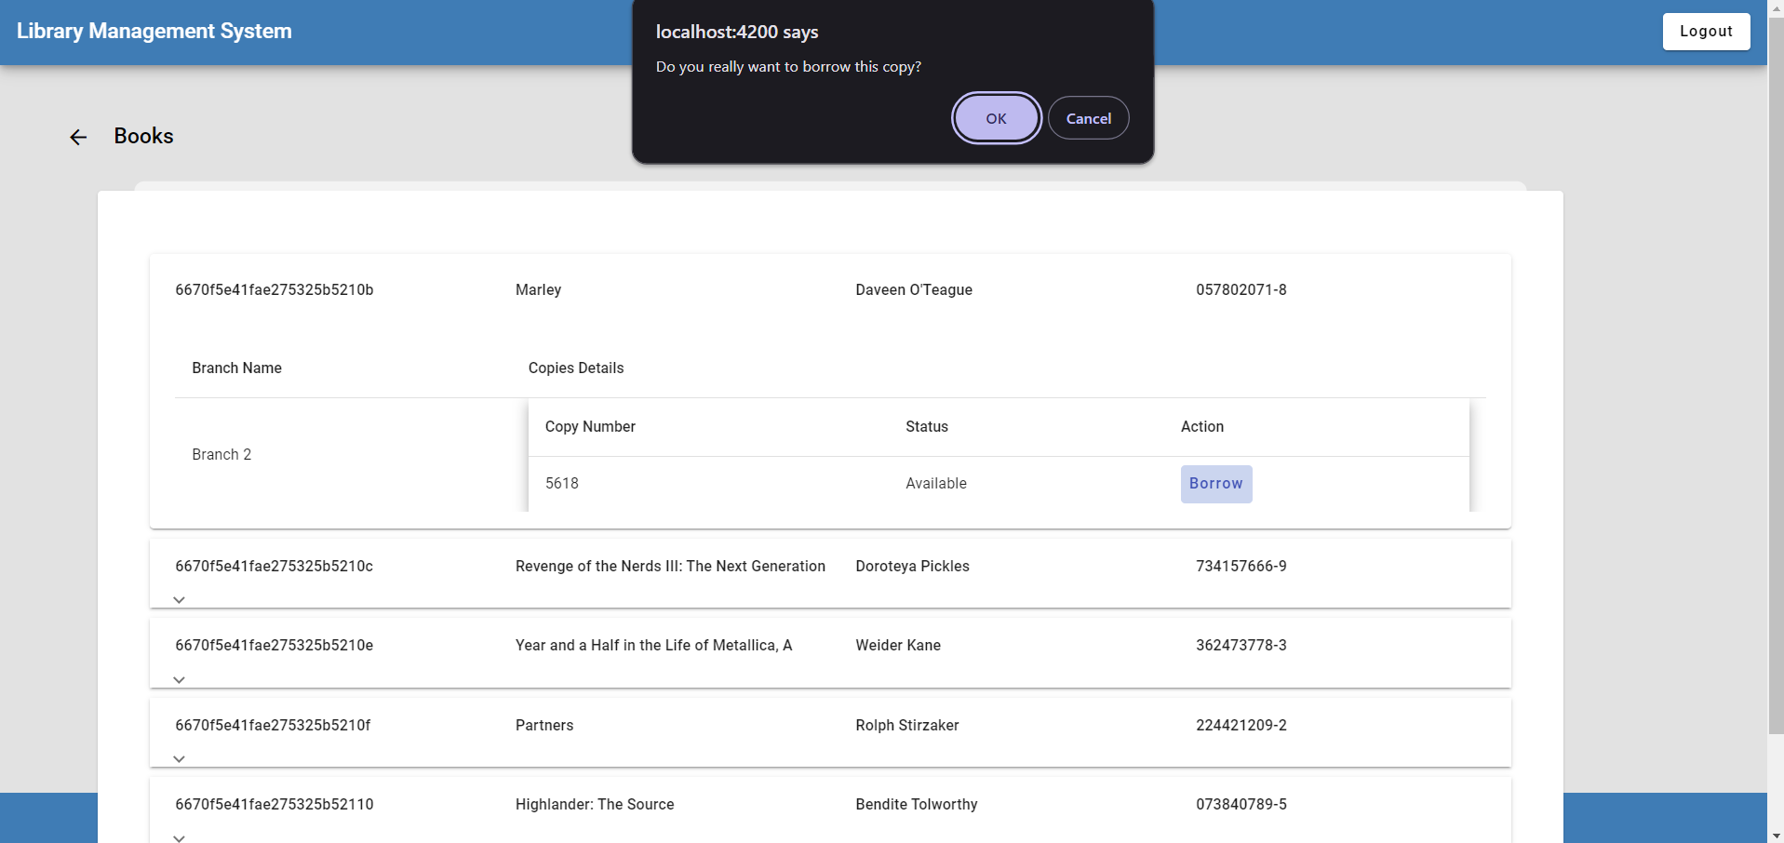
Borrow book

Slide 13
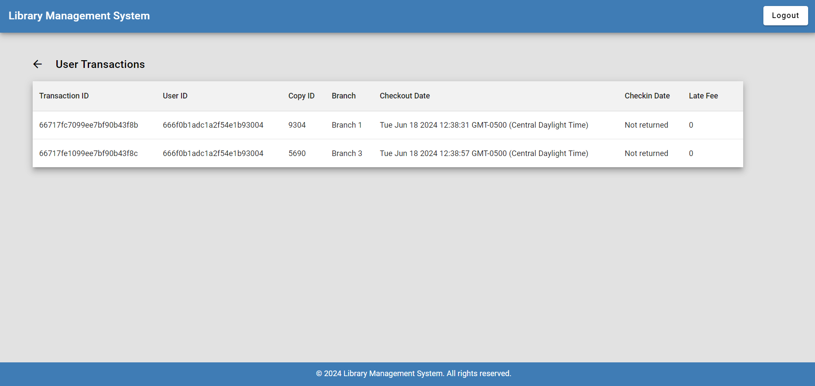
View transactions

Slide 14

Middle ware -
Python: Python serves as the foundation for the LMS, acting as middleware to connect various components
Flask Framework: Flask provides the structure and tools to develop the web application logic for the LMS API endpoints.
pymongo: A Python driver for MongoDB to interact with the MongoDB database, enabling data access, manipulation, and storage for the LMS functionalities.

Slide 15

NoSQL Database -
Flexibility and Scalability: MongoDB's NoSQL structure adapts to evolving data needs.
Document-oriented: Stores data in flexible JSON documents, accommodating complex relationships.
Ideal for Library Data: Efficiently manages diverse data like books, users, and transactions.

Slide 16
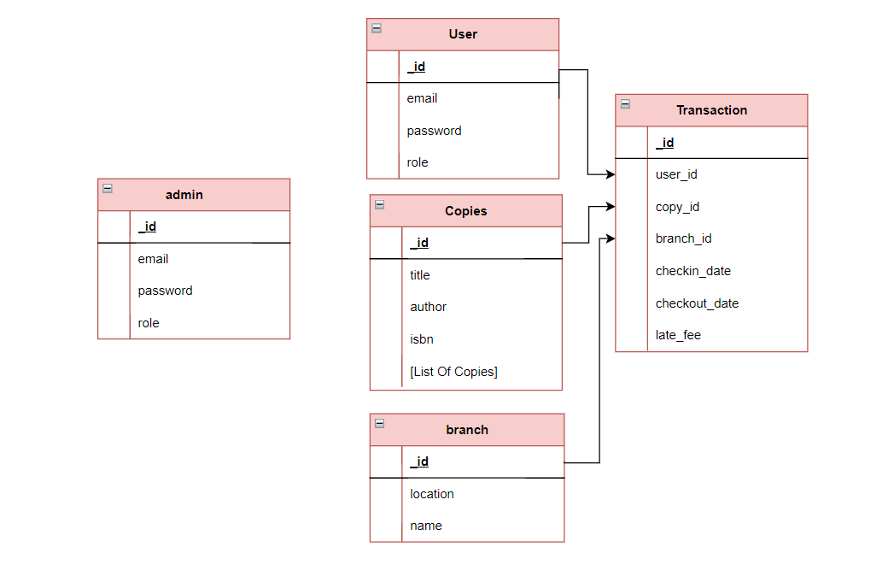
Database Model

Slide 17
Conclusion
Streamlined Operations: The LMS streamlines the login and borrowing books and up-to-date representation of data for efficient library management.
Improved User Experience: User-friendly interface simplifies browsing and borrowing books from branches and checking user transactions in one place.
Scalability and Flexibility: Use of NoSQL DB helps in evolving library needs and data growth.

Slide 18
Thank you ☺

